Slide 1

BetterSwipe
“Better Rewards, Better Savings, Better Swipe”
BLUE TEAM FALL 2023
Prototype Design
CS410

Slide 2
Table of Contents
Choosing a Credit Card Today | #2-4
The Problem | #5-10
Better Swipe | #11-15
Work BreakDown Structure | #16-18
Algorithms | #19-23
Database | #24-25
Development | #26-29
Risk/Mitigations | #30-32
Competition and Constraints | #33-34
Conclusion | #35-36
References | #37-40

Slide 3
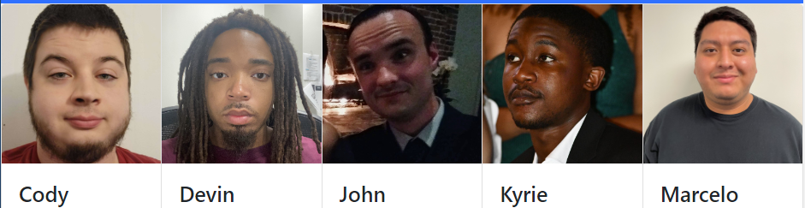
The Team
Cody
Cochran
Algorithm Design
Database Management
Devin
Morgan
Frontend Developer
UI Designer
John
Cartwright
Full-Stack Developer
Kyrie
Champagne
Document Specialist
Backend Developer
Marcelo
Vargas
Webmaster
Algorithm Design
Notes:
Sources: Evans, D. S., & Schmalensee, R. (2005). Paying with Plastic: The Digital Revolution in Buying and Borrowing. MIT Press.

Slide 4

There are too many rewards cards
Too many rewards cards to choose
Credit Karma: 116 (2023)
Nerd wallet: 85 (2023)
Lots of rewards cards make it hard to choose
There are 13 criteria to compare rewards credit cards with (NerdWallet, 2023)
61% of people are overwhelmed by the options (Experian, 2017)
69% of reward credit card holders are underutilizing their rewards (Lambright Black, 2023)

Slide 5
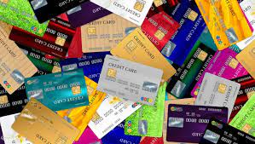
Rewards Cards Can Save You Money
Consumers have a significant potential in savings through the use of rewards credit cards, but choosing the right card to maximize their savings is complicated.
usatoday.com
8
Notes:
Image Sources:
https://www.usatoday.com/money/blueprint/credit-cards/how-many-credit-cards-should-i-have/

Slide 6
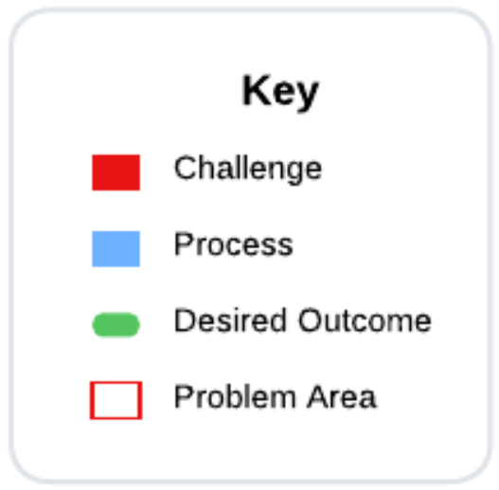
Drowning in Research and Decisions
User wants to obtain a rewards credit card
User analyzes spending habits
User reads up on the rewards of one out of hundreds of cards
No
User estimates how much card could save them
If card is better than current best, note it as the new best
Exhausted yet?
User must begin researching hundreds of cards
Yes
Are rewards leading to saved money?
Obtain card
Continue analyzing expenses
Yes
Card is a good match
Yearly/bi-yearly self review
No

Slide 7
Solution Statement
BetterSwipe is a tool that provides individuals who are seeking to maximize their savings through the use of rewards credit cards by helping them make an informed decision based on their spending profile.

Slide 8
Solution Characteristics
Builds a spending profile from previous transactions
Continuously compares expenditures against current and available cards
Recommends rewards credit cards based on the spending profile
Provides an automatic analysis of expenditures versus card benefits
Analyzes card performances of selected cards against predicted benefits
Simplifies the reward card selection process
Notes:
Image source:
https://www.quicken.com/goals/see-where-my-money-is-going/
businesswoman-relax-from-work-at-the-office.jpg

Slide 9
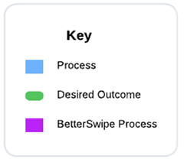
I’d rather Multiple Choice than Fill in the Blank
User wants to obtain a rewards credit card
BetterSwipe analyzes spending habits with bank/card statements and builds a spending profile
Credit card database is searched
Card savings are calculated based on spending profile
Cards with best calculated savings are suggested to the user
User looks between only a few cards
BetterSwipe continues to analyze expenses and update spending profile
Are rewards leading to saved money?
User obtains card
No
Card is a good match
Yes

Slide 10
RWP vs Prototype Features/Capabilities
Functional Element | Real World Product (RWP) | Prototype | Reason
Login/Register | Full Functionality | Full Functionality
Feature encryption of data at rest and in transit | Full Functionality | Full Functionality
Statement Upload | Full Functionality | Partial Functionality | Only accepts Excel-compatible format
Categorization of expenditures | Full Functionality | Partial Functionality | Combination of ML and adjustments
Download rewards details for credit cards cards | Full Functionality | Partial Functionality | Simulating data from a real database baseline
Expenditure Profile Creation/Maintenance | Full Functionality | Full Functionality
Card Recommendations/Comparisons | Full Functionality | Full Functionality
Continuous Monitoring of expenditures/cards | Full Functionality | Partial Functionality | Using simulated data
View reports of expenditures and card recommendations | Full Functionality | Full Functionality

Slide 11
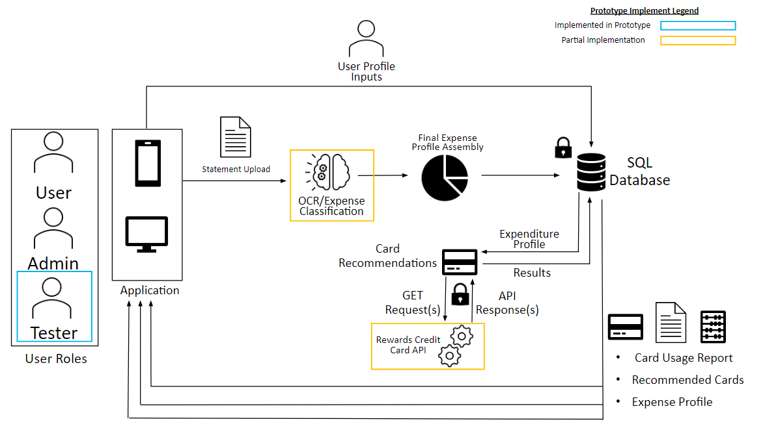
Major Functional Component Diagram
Notes:
Sources: https://shourai.io/blog/2020/07/17/web-application-development-the-basic-concepts/
https://www.allerin.com/blog/what-is-mobile-app-integration

Slide 12
User Roles
New Credit Card Users
Users who are skeptical of credit cards
Wants a handful of meaningful options
Experienced Credit Card Users
Users who want unbiased card recommendations
Looking for real, data-based reward card options
Admins
Users needing elevated privileges for testing and development

Slide 13
Work Breakdown Structure Overview
BetterSwipe
User Interface
Algorithms
Database
Data Management
Testing
UI Flow
Account Setup
User Data
Sources
Hardware
Mockups
Update Spending Profile
Spending Profile
Storage
Software
Find Top Matches
Rewards Cards
Backup
Security

Slide 14
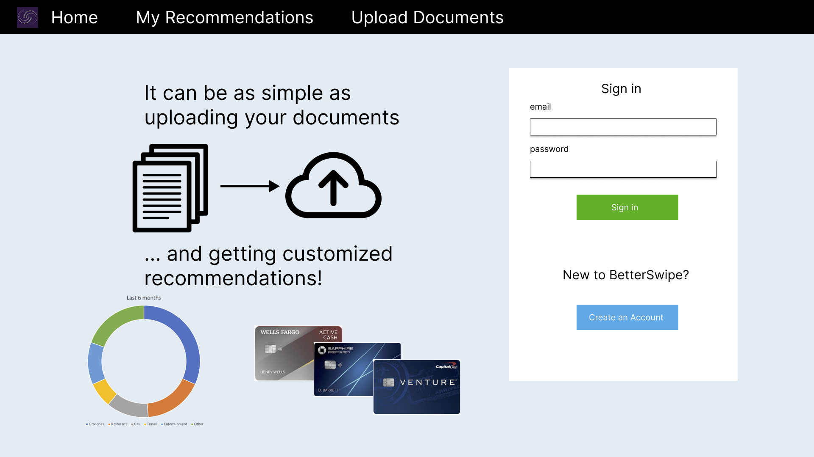
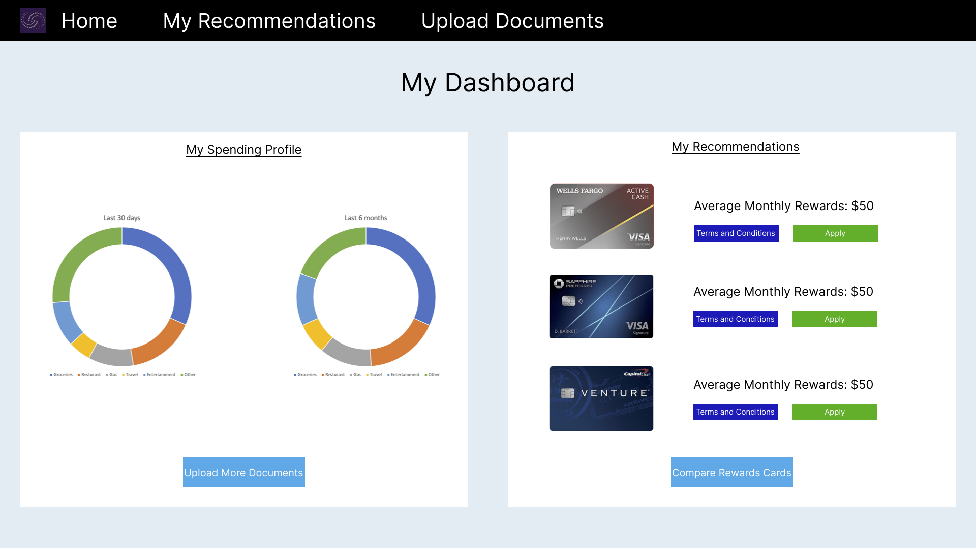
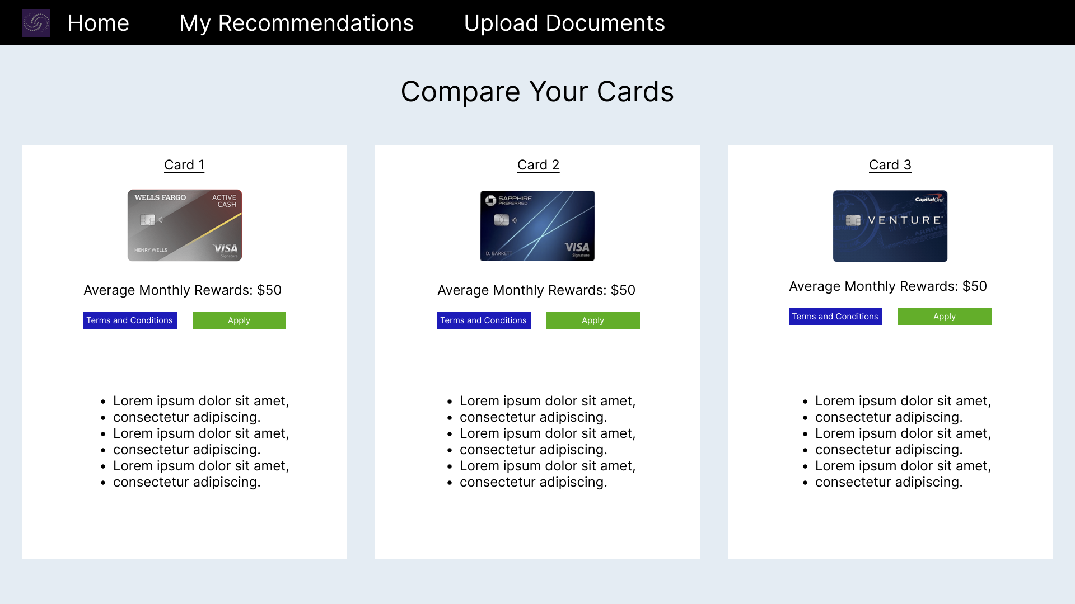
General Pages

Slide 15
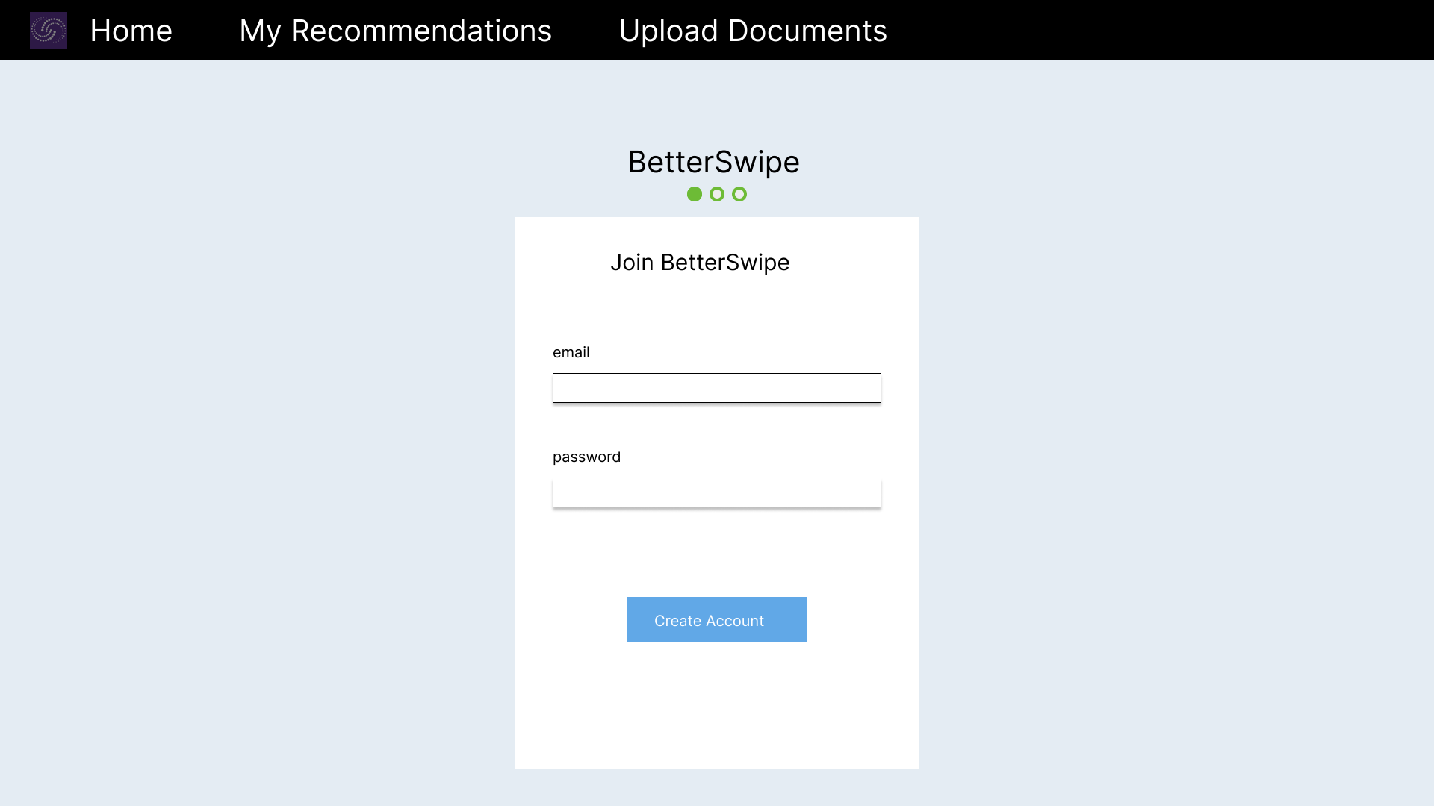
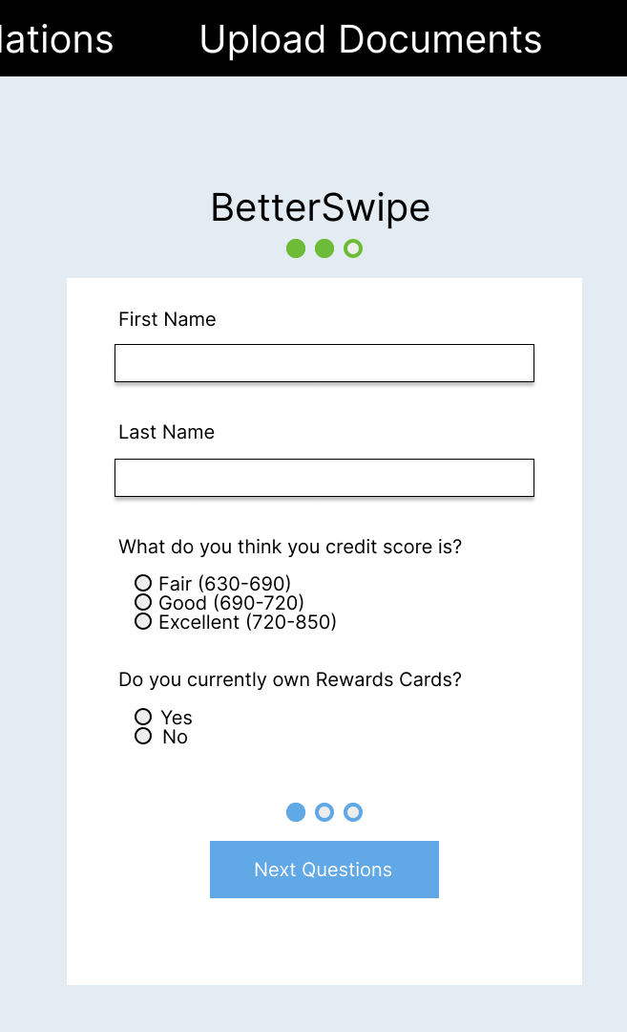
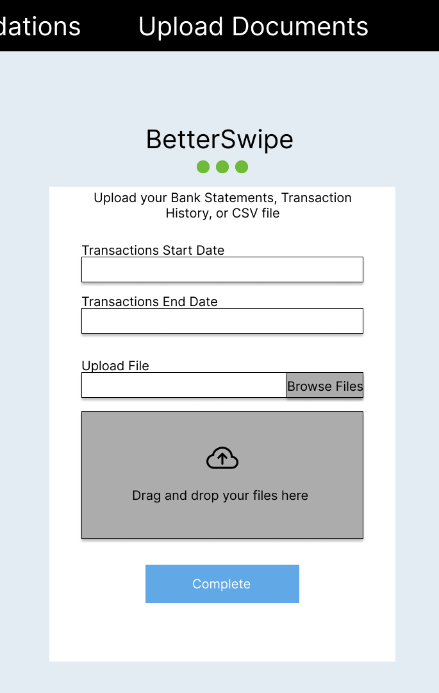
Registration Pages

Slide 16
Algorithms
Create profile
Load Statements
Analyze spending profile
Find top matches
Create new account
Read statement file
Calculate spending category averages
Calculate card scores
Log in
Parse spending data
Sort by highest score
Categorize using AI/ML
Return top 3 to GUI

Slide 17
WBS Algorithms - Create Profile
Start
No
Is there a profile associated with user Email?
User inputs basic user information to create account: email, user name, password,
Valid password and adequate data for user account?
Prompt user to log in
User begins profile creation
No
Yes
Yes
Valid password for that account?
Request user to log in again
No
Yes
Log into user account
User account created and entered into database.

Slide 18
WBS Algorithms - Load Statements
No
User prompted to input bank statements
Valid File Type?
Parse Text
Interpret each line as a transaction
Start
Yes
Has the Last transaction in the list been categorized?
Read transaction and place into a category using Machine Learning
Save transaction to spending profile in database
Yes
Finish
No

Slide 19
WBS Algorithms - Analyzing Spending Profile
Has the Last transaction in the list been categorized?
Read transaction from database
Create a list of average sums for each category per month
Add to the cost sum of the category
Yes
Return Category averages
Start
No

Slide 20
WBS Algorithms - Finding Top Matches
Read averages for every category from user Spending Profile
List of rewards from credit cards
Plug in averages of categories to each credit card
Start
Add value of rewards to list of rewards from credit cards
Sort list by value of rewards
Return the top 3 cards

Slide 21
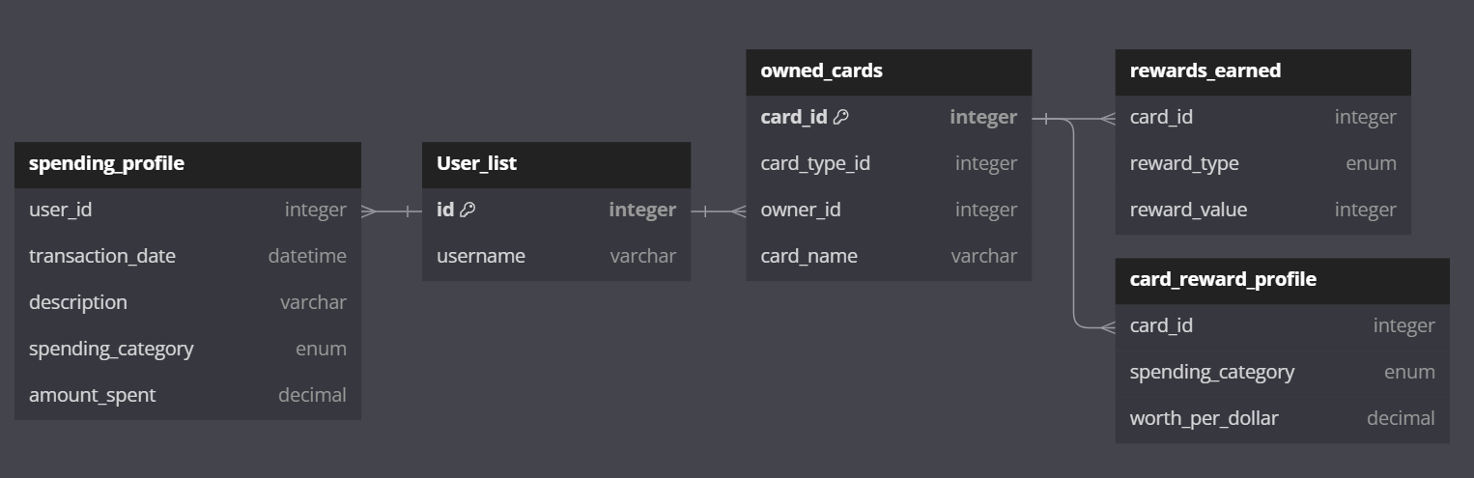
Database Structure

Slide 22

Data Management

Slide 23
Hardware and Software
Hardware
Network-Accessible Devices
PCs
Smartphones
Server system(s) required for hosting
Software
Repository: Github
Database: MySQL
MFA: Duo
Languages: Python, HTML, CSS, Javascript
Machine Learning: Tensorflow

Slide 24
Development Tools
Category | Application
Version Control | Git/Github
Issue Tracking | Trello
Languages | HTML/CSS/JS/Python
Database | MySQL (Amazon RDS)
IDEs | Visual Studio
Components/API | RewardsCC API
Testing | pytest

Slide 25
Prototype User Stories
As a user, I want to be able to scan my bank statement so I don't have to type in all my purchases by hand.
As a user, I would like to see a prediction of how much money a recommended card might save me so I can judge if the recommendation is appropriate.
As a user, I would like to be able to see the top 3 recommended cards, so I have alternate options if I don't like the top recommendation.
As a user, I would like to be able to add information about future purchases (upcoming travel, loans, etc) so that the recommendations I get will apply to my future purchases.
As a user, I would like to receive reminders of rewards that I have and where I can apply them with purchases I am already making so that I can maximize my savings.
As a user, I would like to be certain that my personal and banking information is securely transmitted and stored.
As a user, I would like to be able to see all my transaction categorized

Slide 26
Prototype User Stories
As a user, I want to be able see information about the rewards cards, i.e APR and specifics on rewards and their uses
As a user, I would like to be able see constant recommendations of rewards cards based on my constantly updated bank statements
As I used I would like to be able to periodically upload more statements after the initial use.
As a user, I would like to receive a general summary of how much I would earn if I selected one of the suggestions.
As a user, I would like to for recommendations to be personalized to match my necessities and spending history
As a user, I would like to see past transactions and rewards history
As a user, I would like to be able to see a history of my past results.
As a user, I want an easy to use interface.

Slide 27
Tester User Stories
As a test user, I want to identify and accurately document any bugs, vulnerabilities, or errors found in the application.
As a test user, I want to verify that the application displays detailed information about various rewards cards, including interest rate and specific rewards, to ensure users can make informed decisions.
As a test user, I want to be able to trigger the 2FA for testing.
As a test user, I want to ensure that erroneous inputs are checked in order to maximize accuracy.
As a test user, I want to ensure that the application provides an accurate summary of potential earnings from suggested rewards cards, helping users understand the benefits.
As a test user, I want to test the ability of the application to display a user's past transactions and rewards history, ensuring the information is accurate and comprehensive.
As a test user, I need to confirm that the application maintains and accurately displays a history of the user's past card recommendations and selections.

Slide 28
Tester User Stories
As a test user, I need to assess whether the application accurately predicts the monetary savings a recommended card can offer, aiding users in decision-making.
As a test user, I want to test the capability of the application to incorporate information about future purchases into its recommendation algorithm.
As a test user, I need to confirm that the application effectively reminds users of available rewards and their applicability to current purchases.
As a test user, I aim to rigorously test the security measures in place for transmitting and storing personal and banking information.
As a test user, I want to verify that the application categorizes all transactions accurately, aiding users in tracking their spending and rewards.
As a test user, I want to evaluate the application's interface for ease of use, ensuring that it is user-friendly and intuitive.

Slide 29
Agile Sprints
Sprint 0 (2 weeks)
Establish development environment
Account Roles/Authentication
DB Setup
UI Scaffolding
Sprint 2 (3 weeks)
API Integration
Continue evolving UI
Data Categorization
Sprint 4 (3 weeks)
Predictive Savings Analysis
User Historical Comparison
Sprint 1 (3 weeks)
ML Creation
Evolve UI
Financial Statement Upload
DB refinement
Sprint 3 (3 weeks)
Card Recommendations
Expenditure Dashboard
Incorporate User Information
Sprint 5 (2 weeks)
Final integration
Full functional testing

Slide 30
Security Risk Matrix
Security Risks
S1.Risk of Personal Identifiable Information (PII) and sensitive information
S2. Unauthorized profile access
S3. Use of API(s)
Mitigations
S1. Require strong passwords to prevent unauthorized users from accessing data. (Fully addressed)
S1. Encrypt data-at-rest and in-transit (Fully addressed)
S2. Strong password requirements, and salt password hashes (Partially addressed)
S3. Implement API Gateway and SSL/TLS (Partially addressed)
5 Very Likely
4 Likely
3 Possible
2 Unlikely
1 Very Unlikely
 |  | S3 | S2 | S1
 | S3 | S2 | S1
Probability
1 insignificant 2 minor 3 moderate 4 significant 5 catastrophe
Impact

Slide 31
Customer Risk Matrix
Customer Risks
C1. Customer does not find satisfactory solution
C2. Customer adds erroneous inputs
C3. Customer chooses card(s) they are not approved for
Mitigations
C1. Suggest user make adjustments to their profile / preferences (Fully Implemented)
C2. Implement input validation and allow user to confirm choices (Fully Implemented)
C3. Allow for user to input credit score and cards they own to only make make recommendations for new cards within a suitable credit score range (Fully Implemented)
5 Very Likely
4 Likely
3 Possible
2 Unlikely
1 Very Unlikely
 | C1 | C2
 | C3
 | C1 | C2
 | C3
Probability
1 insignificant 2 minor 3 moderate 4 significant 5 catastrophe
Impact

Slide 32
Technical Risk Matrix
Technical Risks
T1. App unable to access API(s)
T2. Data from credit card providers not up to date
Mitigations
T1. Test API(s) and cache responses (Partially Implemented)
T2. Consistently monitor API(s) for updates and implement most up-to-date card information (Partially Implemented)
5 Very Likely
4 Likely
3 Possible
2 Unlikely
1 Very Unlikely
 |  |  | T1
 |  | T2
 | T2 |  | T1
Probability
1 insignificant 2 minor 3 moderate 4 significant 5 catastrophe
Impact

Slide 33
Conclusion - Key Points Summary
Searching for credits cards has become problematic over the years with the addition of credit card rewards.
The differences between credit card rewards and their quantity are what make this issue a problem to be solved.
BetterSwipes goal is to make this process easier and allow people to find a credit card tailored to their needs.
Using Machine Learning to read bank statements to tailor credit card options.
Educating customers on how to properly using credit cards for their benefit.
There is some risk in BetterSwipe.
Potential for user information being wrongly accessed and leaked.
Constant monitoring of card information for updates.

Slide 34
“Better Rewards, Better Savings, Better Swipe”
Questions?

Slide 35
References
Akash Chauhan, & Anshu Goal. (2023). Comparative study between debit card & credit card users in Greater Noida City.
Bankrate. (n.d.). Are rewards credit cards worth it?, from https://www.bankrate.com/finance/credit-cards/are-rewards-credit-cards-worth-it/#pros-cons
Bankrate. (n.d.). Are rewards credit cards worth it?, from https://www.bankrate.com/finance/credit-cards/are-rewards-credit-cards-worth-it/#pros-cons
Bankrate. (n.d.). How to choose a rewards credit card., from https://www.bankrate.com/finance/credit-cards/choose-rewards-credit-card/
Capital One. (2023). Venture. Retrieved from https://applynow.capitalone.com/?irgwc=1&external_id=IRAFF_ZZce293c61587c41c29a64c5685cb78e40_USCIR_K170911_A344893L_C0bcf2f83N684a11ee9b4547fc6474d6a_S_P&transid=&marketingChannel=P23235&oC=COh7rTP9h&productId=24919
Credit Karma. (2023). Compare credit cards &amp; apply online instantly. Intuit Credit Karma. https://www.creditkarma.com/credit-cards/search-cc

Slide 36
References
Chase. (2023). Sapphire Preferred. Retrieved from https://creditcards.chase.com/a1/23Q3a/sapphirepreferred/compare?CELL=6H8X&AFFID=SWlnSnn6x54-uFq.wEnPmd6AIGJp3kVUng&pvid112b6c9a7e784f3fba5eec3490744a4b&jp_cmp=cc/1431835/aff/15-31715/na
Dodgson, L. (2018, October 4). Why Too Much Choice Is Bad. Business Insider. https://www.businessinsider.com/why-too-much-choice-is-bad-2018-10
DOI.org. (2023). International Journal of Finance and Managerial Research, 05(03). https://dx.doi.org/10.36948/ijfmr.2023.v05i03.2874
Experian. (2017). Survey Findings: How Do Consumers Feel About Credit Cards? https://www.experian.com/blogs/ask-experian/survey-findings-how-do-consumers-feel-about-credit-cards/
Fontinelle, A. (2021, May 17). Credit Cards vs. Debit Cards: What's the Difference? Investopedia. Retrieved October 11, 2023, from https://www.investopedia.com/articles/pf/10/credit-card-debit-card.asp
GÜL, Z., & İŞCAN, O. (2022). Understanding Consumer Behavior towards Credit Card Usage in Bangladesh. ISARDER. Retrieved October 11, 2023, from https://isarder.org/index.php/isarder/article/view/1693/1642

Slide 37
References
Kurien, R., Paila, A. R., & Nagendra, A. (2014). Application of paralysis analysis syndrome in customer decision making. Procedia Economics and Finance, 11, 323-334.
Lambright Black, M. (2022, August 15). Study: Millions Leave Credit Card Rewards Unredeemed. LendingTree. Retrieved October 11, 2023, from https://www.lendingtree.com/credit-cards/study/unused-rewards/
NerdWallet. (2023). What’s the Value of Capital One Miles? Retrieved from https://www.nerdwallet.com/article/travel/capital-one-miles-value#:~:text=Capital%20One%20miles%20are%20worth,transfer%20partners%20at%201.4%20cents.
NerdWallet. (2023). What’s the Value of Chase Ultimate Rewards Points? Retrieved from https://www.nerdwallet.com/article/travel/chase-ultimate-rewards-points-value#:~:text=Based%20on%20our%20most%20recent,Ultimate%20Rewards%C2%AE%20redemption%20options.
NerdWallet. (2023, July 7). How to Read the Schumer Box on a Credit Card. Retrieved October 11, 2023, from https://www.nerdwallet.com/article/credit-cards/how-to-read-schumer-box

Slide 38
References
The Motley Fool. (2020). Credit and Debit Card Market Share by Network and Issuer. Retrieved from https://www.fool.com/the-ascent/research/credit-debit-card-market-share-network-issuer/
Pokora, B. (2023, March 9). Credit Card Statistics: 23 Must-Know Data Points for 2023. Forbes. Retrieved October 11, 2023, from https://www.forbes.com/advisor/credit-cards/credit-card-statistics/
ScienceDirect. (2014). The Effect of Too Many Choices on Consumer Satisfaction in Online Sales Environments. https://www.sciencedirect.com/science/article/pii/S2212567114002007/pdf?md5=26ae6e12a34221c1f26fe30622eafbee&pid=1-s2.0-S2212567114002007-main.pdf&_valck=1
Wells Fargo. (2023). Wells Fargo Active Cash Card. Retrieved from https://creditcards.wellsfargo.com/cards/active-cash-credit-card/?product_code=CC&subproduct_code=AC&FPID=0126D7IDF40000&vendor_code=LS&sub_channel=AFF&siteID=SWlnSnn6x54-VBFI3LHxdVpqwHmPYdNihg

Slide 39
Image Source
https://shourai.io/blog/2020/07/17/web-application-development-the-basic-concepts/
https://www.allerin.com/blog/what-is-mobile-app-integration
https://credit.org/blog/the-benefits-of-having-credit-cards/
https://www.quicken.com/goals/see-where-my-money-is-going/
https://www.usatoday.com/money/blueprint/credit-cards/how-many-credit-cards-should-i-have/
https://www.google.com/url?sa=i&url=https%3A%2F%2Fwww.sharecare.com%2Fmental-health-behavior%2Fstress-management%2F8-warning-signs-of-too-much-stress&psig=AOvVaw3YHRcYnBJ3YixeBKOiTGpJ&ust=1697662494403000&source=images&cd=vfe&opi=89978449&ved=0CBAQjRxqFwoTCLCTv-T7_YEDFQAAAAAdAAAAABAL

